Slide 1
MIS 637: Data Analytics and Machine Learning
School of Business
Stevens Institute of Technology
Introduction Continued
M. Daneshmand
Mahmoud.Daneshmand@stevens.edu
Fall 2023

Slide 2
Intro from the Text:
Data Mining and Analysis: Foundations and Algorithms, Mohammed J. Zaki and Wagner Meira, Jr,
Cambridge University Press, 2013
Modified by MD

Slide 3
Traditional Hypothesis Driven Research
Hypothesis
Design
Experiment
Data
Data analysis
Result

Slide 4

Data Driven Science
Process/Experiment
Data
No Prior Hypothesis
New Science of Data

Slide 5
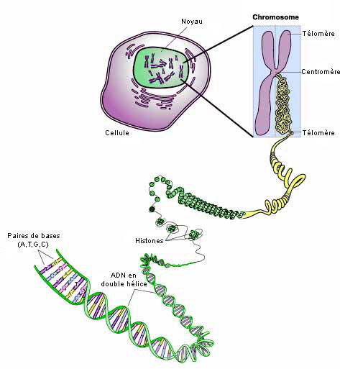
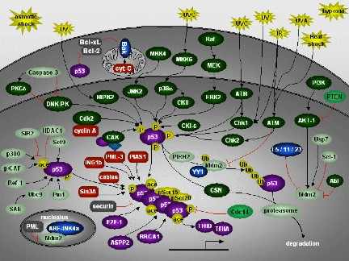

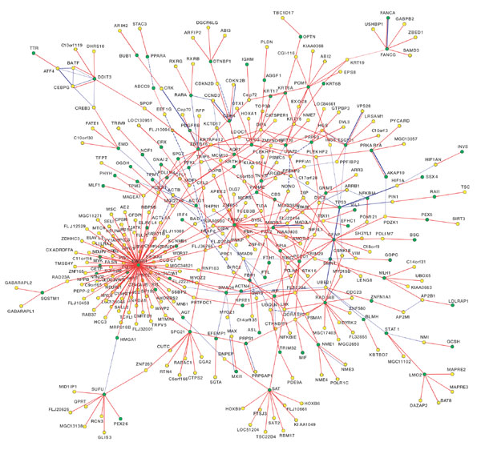
Bioinformatics
Datasets:
Genomes
Protein structure
DNA/Protein arrays
Interaction Networks
Pathways
Metagenomics
Integrative Science
Systems Biology
Network Biology

Slide 6

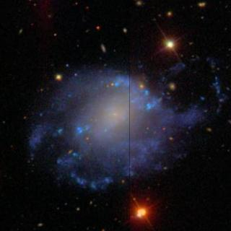
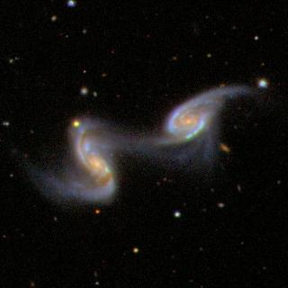
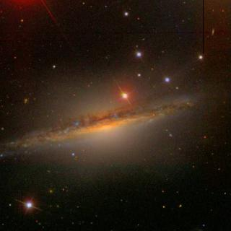
Astro-Informatics: US National Virtual Observatory (NVO)
New Astronomy
Local vs. Distant Universe
Rare/exotic objects
Census of active galactic nuclei
Search extra-solar planets
Turn anyone into an astronomer

Slide 7
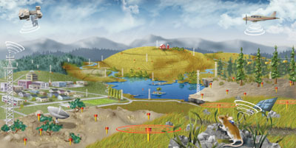
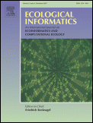
Ecological Informatics
Analyze complex ecological data from a highly-distributed set of field stations, laboratories, research sites, and individual researchers

Slide 8
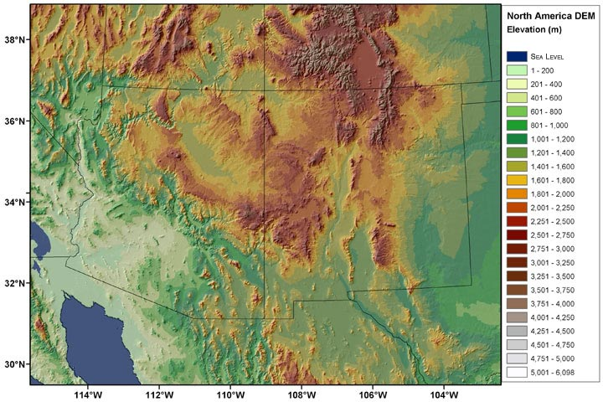
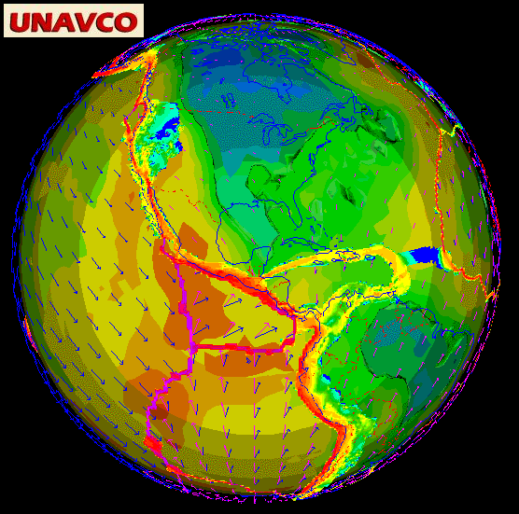
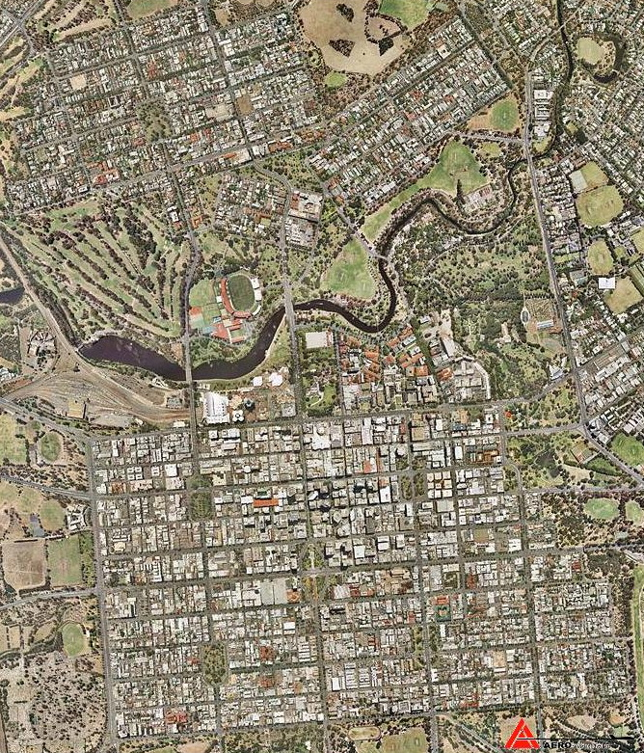
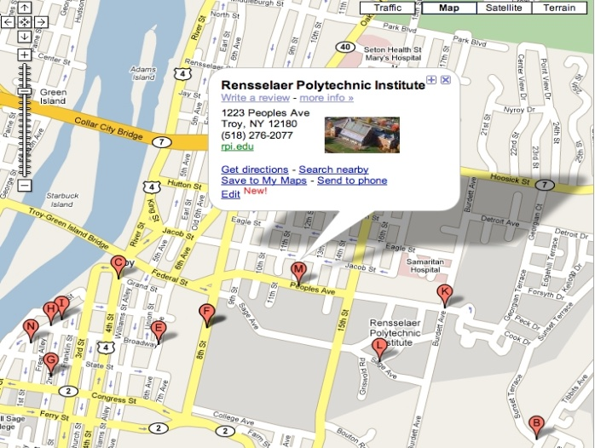
Geo-Informatics/Data

Slide 9






Temporal-Data: Services in WSN (Wireless Sensor Networks)
Data
Data
Sender
Receiver
A sample data communication in conventional networks
Fire!
Some bits
01100011100
Core network
e.g. Internet
End-user
Sink
node
Gateway
A sample data communication in WSN

Slide 10
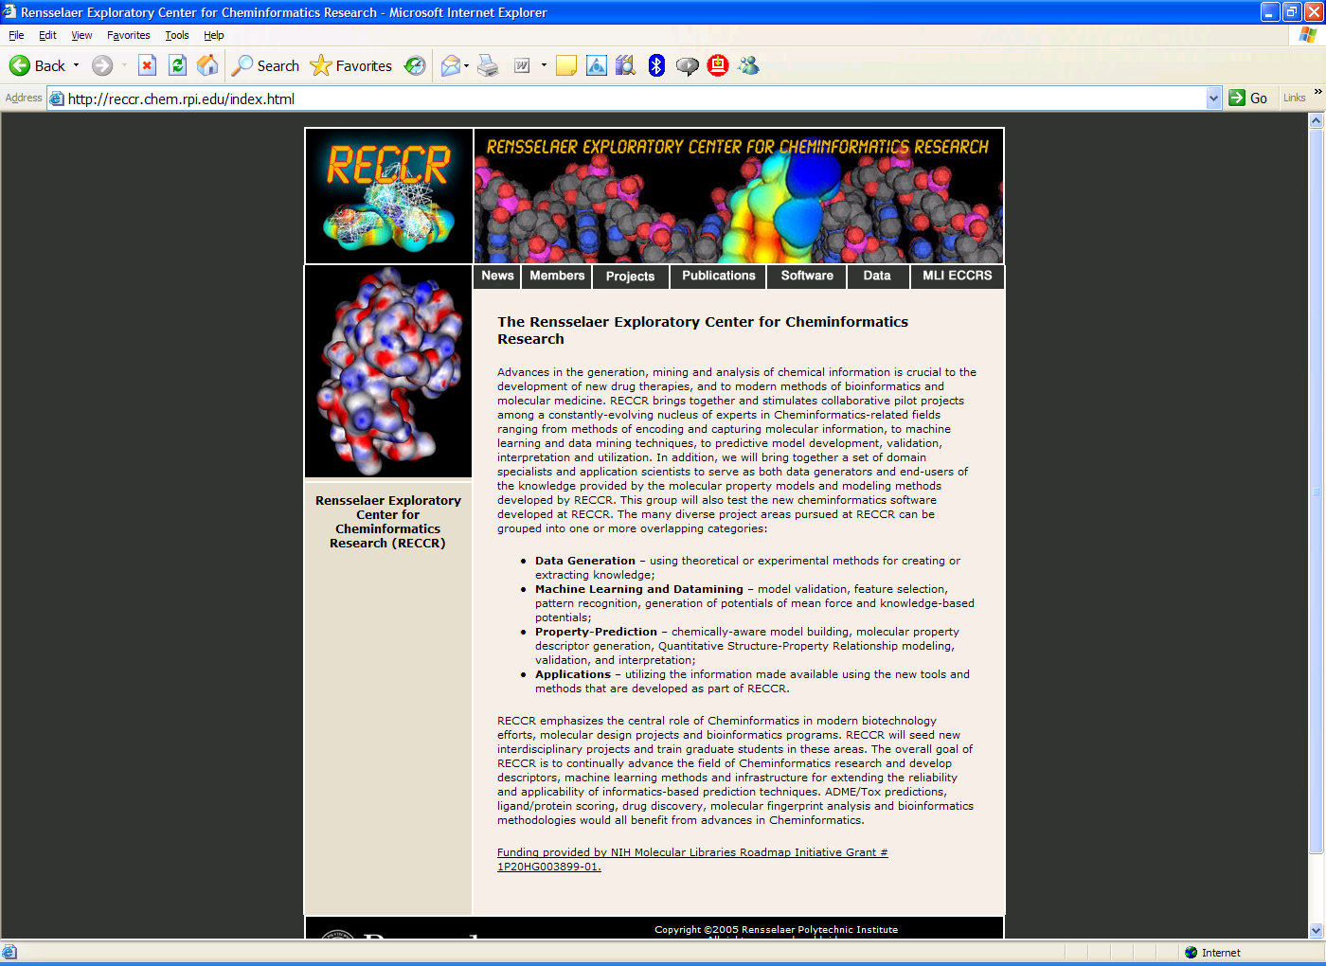

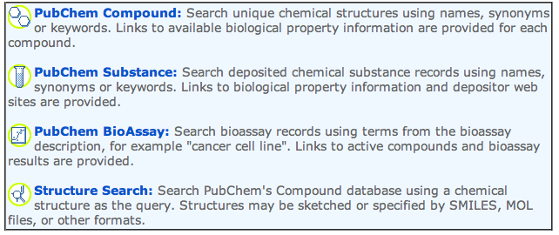
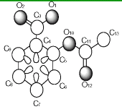
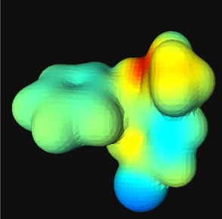
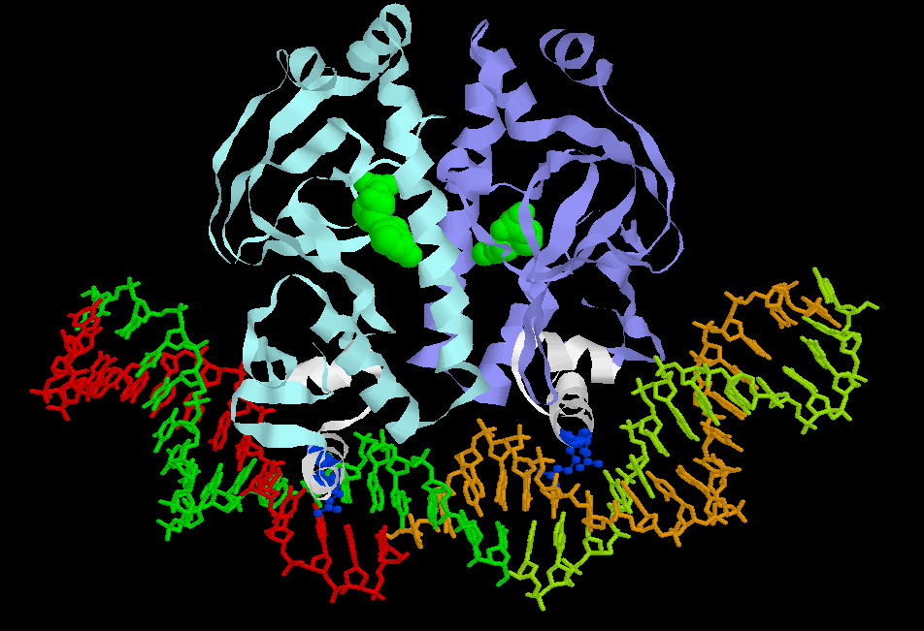
Cheminformatics
Structural Descriptors
Physiochemical Descriptors
Topological Descriptors
Geometrical Descriptors
AAACCTCATAGGAAGCATACCAGGAATTACATCA…

Slide 11
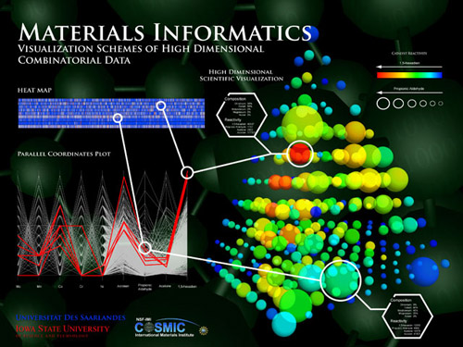
Materials Informatics

Slide 12
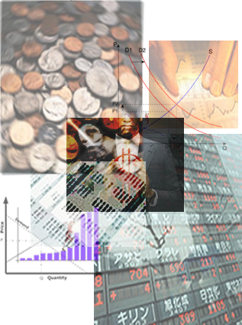
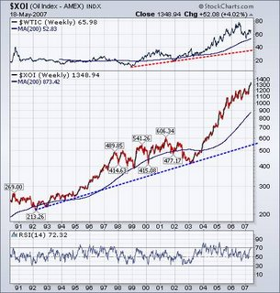
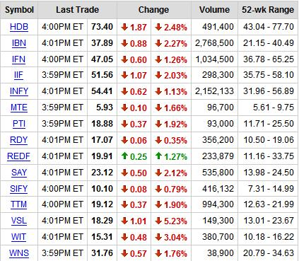
Temporal-Data: Economics & Finance

Slide 13
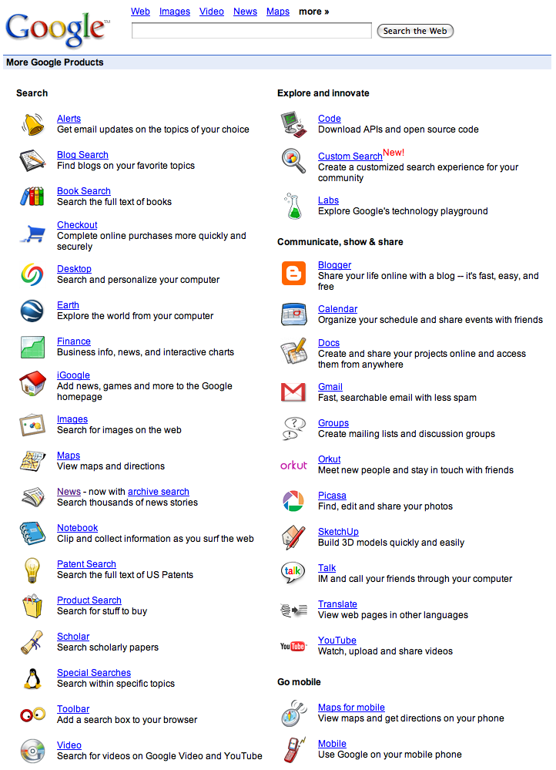

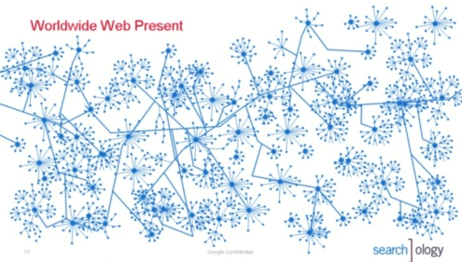
World Wide Web

Slide 14
What is Data Mining &Analytics?
The iterative and interactive process of discovering valid, novel, useful, and understandable patterns or models in Massive databases

Slide 15
What is Data Mining & Analytics?
Valid: generalize to the future
Novel: what we don't know
Useful: be able to take some action
Understandable: leading to insight
Iterative: takes multiple passes
Interactive: human in the loop

Slide 16
Why Data Mining & Analytics?
Massive amounts of data being collected in different disciplines
Biology, Chemistry, Materials science, Astronomy, Ecology, Geology, Economics, and many more
Search for a systematic way to address the challenges across/at the intersection of the diverse fields
Leverage the unique strengths of each area
Techniques from bioinformatics can be applied to other areas (like network intrusion detection)
Game theory from Economics can be applied to problems in CS
Database development in Astronomy can help Ecology applications
Enable Data-informatics: bio-, chem-, eco-, geo-, astro-, materials- informatics

Slide 17
Why Data Mining & Analytics?
Dynamic nature of modern data sets: streams
Massive and distributed datasets: tera-/peta-scale
Various modalities:
Tables
Images
Video
Audio
Text, hyper-text, “semantic” text
Networks
Spreadsheets
Multi-lingual

Slide 18
Data mining: Main Goals
Prediction
What?
Opaque
Description
Why?
Transparent
Age
Model
Salary
High/Low Risk
CarType
outlier

Slide 19
Data Mining & Analytics: Main Techniques
Association rules: detect sets of attributes that frequently co-occur, and rules among them, e.g. 90% of the people who buy book X, also buy book Y (10% of all shoppers buy both)
Sequence mining (categorical): discover sequences of events that commonly occur together, .e.g. In a set of DNA sequences ACGTC is followed by GTCA after a gap of 9, with 30% probability

Slide 20
Data Mining & Analytics: Main Techniques
Classification and regression: assign a new data record to one of several predefined categories or classes. Regression deals with predicting real-valued fields. Also called supervised learning.
Clustering: partition the dataset into subsets or groups such that elements of a group share a common set of properties, with high within group similarity and small inter-group similarity. Also called unsupervised learning.

Slide 21
Data Mining & Analytics: Main Techniques
Deviation detection: find the record(s) that is (are) the most different from the other records, i.e., find all outliers. These may be thrown away as noise or may be the “interesting” ones.
Similarity search: given a database of objects, and a “query” object, find the object(s) that are within a user-defined distance of the queried object, or find all pairs within some distance of each other.

Slide 22
Knowledge Discovery Process
Interpretation
Data Mining
Transformation
Preprocessing
Knowledge
Selection
Patterns
Transformed
Data
Preprocessed
Data
Original
Data
Target
Data

Slide 23
Data Mining & Analytics Process
Understand application domain
Prior knowledge, user goals
Create target dataset
Select data, focus on subsets
Data cleaning and transformation
Remove noise, outliers, missing values
Select features, reduce dimensions

Slide 24
Data Mining Process
Apply data mining algorithm
Associations, sequences, classification, clustering, etc.
Interpret, evaluate and visualize patterns
What's new and interesting?
Iterate if needed
Manage discovered knowledge
Close the loop

Slide 25
Components of Data Mining Methods
Representation: language for patterns/models, expressive power
Evaluation: scoring methods for deciding what is a good fit of model to data
Search: method for enumerating patterns/models

Slide 26
New Science of Data
New data models: dynamic, streaming, etc.
New mining, learning, and statistical algorithms that offer timely and reliable inference and information extraction: online, approximate
Self-aware, intelligent continuous data monitoring and management
Data and model compression
Data provenance
Data security and privacy
Data sensation: visual, aural, tactile
Knowledge validation: domain experts

Slide 27
Data Science Core Areas
Data Mining and Machine Learning
Mathematical Modeling and Optimization
Databases and Data warehousing
High Performance Computing
Data Compression/Representation
Statistics, Algebra, and Geometry
Visualization, Sonification
Social/ethical/legal Dimensions
Application Domains
Biology, medicine, chemistry, astronomy, finance, economics, geology, environment, materials, large-scale simulations, national security, WWW

